Slide 1




Snowflake Schema & Databricks Integration
DATADOSE ANALYTICS PLATFORM
DataDose

Slide 2


Agenda
01. Module Overview & Goals
09. Installation Workflow
02. Key Features & HIPAA Compliance
10. Data Flow Pipeline
03. Technology Stack
11. Configuration (sf_options)
04. 4-Layer Architecture
12. Implementation Highlights
05. Data Warehouse Design (SCD Type 2)
13. Performance Clustering
06. Snowflake DB Schema
14. Best Practices
07. Azure Databricks Integration
15. Project Impact & Scalability
08. Security & Key Vault Setup
16. Summary & Questions
DataDose

Slide 3



Module Overview
The analytical core of the DataDose Platform, providing a high-performance, 4-layer Cloud Data Warehouse.
Storage
Centralized Pharma Analytics DB.
Primary Purpose
Security
To transform raw JSON pharmaceutical events into structured, historical insights while maintaining strict clinical security standards.
HIPAA-compliant patient de-identification.
Integration
Seamless Databricks to Snowflake bridge.
DataDose

Slide 4






Key Features
4-Layer DW
SCD Type 2
HIPAA De-ID
Structured flow: Staging → Dimensions → Facts → Analytics.
Historical drug record tracking using Effective/Expiry dates.
DIM_PATIENT stores only hashed tokens. Zero PII persisted.
VARIANT Support
Graph Export
Performance
Full raw JSON lineage stored in VARIANT columns.
Pre-built views for Neo4j AuraDB node/rel imports.
Micro-partition clustering and search optimization.
DataDose

Slide 5





Technology Stack
Data Warehouse
Infrastructure
Azure Key Vault (Secrets)
Snowflake Spark Connector (v2.15.0)
JDBC Driver (v3.14.4)
Snowflake RBAC (PYSPARK_ROLE)
Compute & ETL
Snowflake Python Connector
DataDose

Slide 6
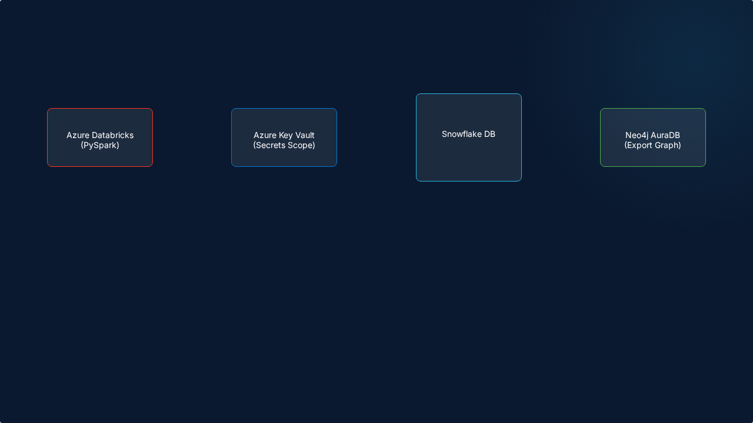

System Architecture
STAGING | DIM | FACT
• Databricks cluster reaches Snowflake on Port 443.
• Warehouse: PHARMA_WH (X-SMALL → LARGE).
• Secrets bridged via linked Databricks Secret Scope.
• Role-based access via PYSPARK_ROLE.
DataDose

Slide 7

Warehouse Design Layers
01. Staging
03. Facts
Raw JSON persisted in VARIANT format. Maintains 100% data lineage and enables ELT reprocessing.
FACT_PRESCRIPTION_TRANSACTION. Grain: Single prescription event. Linked via surrogate keys.
02. Dimensions
04. Analytics
Master data for Drugs, Ingredients, Patients, and Pharmacies. Implements SCD Type 2 for Drug history.
Precomputed rollups and export views (e.g., V_DRUG_INTERACTION_GRAPH) for rapid dashboarding.
DataDose

Slide 8

Snowflake Schema Visualization
PHARMA_ANALYTICS_DB
Relationships
STAGING: STG_DRUG_METADATA, STG_TRANSACTION
• Surrogate Keys (INT) for all Dimension/Fact links.
DIMENSIONS: DIM_DRUG (SCD2), DIM_PATIENT (Hashed), DIM_DATE (2020-2030 spine)
• Many-to-Many bridge: DIM_DRUG_INGREDIENT.
• Micro-partitioning by TX_DATE_SK and PHARMACY_SK.
FACTS: FACT_PRESCRIPTION_TRANSACTION
ANALYTICS: PATIENT_RISK_PROFILE, DRUG_INTERACTION_SUMMARY
DataDose

Slide 9
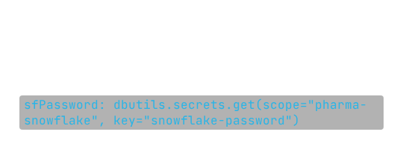

Azure Databricks Integration
Secret Bridging
Connection Flow
Using dbutils.secrets for zero-credential exposure in code.
1. PySpark Setup via sf_options.
2. Spark Connector translates Spark SQL to Snowflake pushdowns.
3. Direct JDBC used for DDL and status updates.
Snowflake Pushdown: Filtering and projections happen at the Snowflake layer, minimizing data transfer to Databricks.
DataDose

Slide 10

Security & Compliance
Azure Key Vault
RBAC
Masking
Centralized secret management. Rotation-ready credentials.
PYSPARK_ROLE with FUTURE table grants. Minimal privilege principle.
Dynamic Data Masking for non-clinical analytical roles.
HIPAA Compliance: Time Travel (90 days) and Fail-safe (7 days) provide a complete audit trail of every drug interaction record change.
DataDose

Slide 11






Installation Workflow
Maven Coordinates: net.snowflake:spark-snowflake_2.12:2.15.0-spark_3.4
JDBC Driver: net.snowflake:snowflake-jdbc:3.14.4
DataDose

Slide 12


Data Flow Pipeline
RAW DATA (JSON/CSV)
NEO4J EXPORT VIEW
DataDose

Slide 13
Configuration Parameters
Parameter | Source | Description
sfURL | Snowflake Account | The computing endpoint for the account.
sfUser | Key Vault | The Service User (PYSPARK_SVC).
sfWarehouse | Snowflake SQL | The Virtual Warehouse (PHARMA_WH).
sfSchema | Notebook Override | Can target STAGING, FACTS, or DIMENSIONS.
sfRole | Snowflake Role | PYSPARK_ROLE for RBAC compliance.
DataDose

Slide 14

Implementation Highlights
SCD Type 2 Pattern
Clustering Design
• Historical drug tracking.
• Auto-clustering on FACT_PRESCRIPTION_TRANSACTION.
• RECORD_VERSION tracking.
• Clustering keys: TX_DATE_SK, PHARMACY_SK.
• IS_CURRENT boolean for latest data.
• Minimizes partition scanning for time-series reports.
Safe Read Pattern: Custom PySpark helper with targeted error diagnostics for credential, network, and JAR failures.
DataDose

Slide 15

Best Practices
Security
Engineering
1. Use Service Accounts (SVC) only.
1. Favor mode("append") to staging.
2. Rotate keys in Key Vault frequently.
2. Use VARIANT to avoid data loss from schema drift.
3. Enforce MFA for human admin users.
3. Standardize on ISO Date surrogate keys.
4. Monitor Snowflake login history for SVC anomalies.
4. Override sfSchema dynamically for cross-schema tasks.
DataDose

Slide 16

Project Impact
90%
Zero
100%
Faster query retrieval using search optimization on dimension lookups.
PII data stored in Snowflake, ensuring total HIPAA compliance.
Data lineage retained via VARIANT staging architecture.
"Choosing Snowflake + Databricks allows DataDose to scale from thousands to millions of prescriptions while maintaining sub-second analytical response times."
DataDose

Slide 17
Summary & Key Takeaways
• Enterprise Scale: Built on Snowflake Standard + Databricks 13.3 LTS.
• Secure by Design: Key Vault secrets, RBAC, and Patient Tokenization.
• Clinical Ready: SCD Type 2 history tracking for full drug record auditability.
• Analytics Enabled: Ready for BI, ML, and Neo4j graph processing.
DataDose

Slide 18
Questions?
Thank you for your time.
Snowflake Schema v2.0 | Databricks Integration v3.0
DataDose

